Slide 1
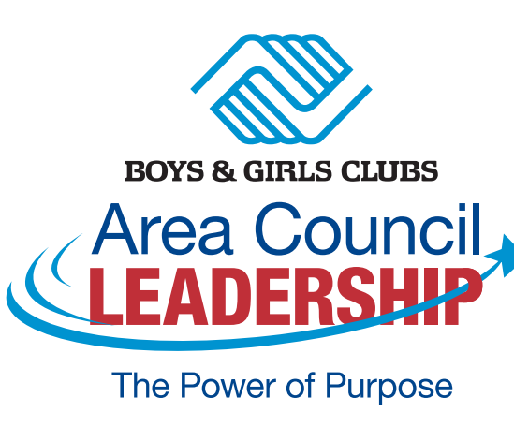
Area Council Liaison Orientation
Notes:
Welcome to the Area Council Liaison Orientation. (INTRODUCE YOURSELF). I personally want to thank each of you for what you do every day for Clubs, kids and the communities you serve.
I also want to thank you for serving in this very important role. Your role is critical in helping this great Movement of ours achieve the impact we desire for youth. The Area Council Liaison is the link between the local Club and your Area Council and provides ideas, feedback and recommendations on key Movement wide issues.
Our goal today is to provide you with some information about this role and an opportunity to dialogue and ask questions in order to help you be successful. At the end of this learning experience, you will:
1. Better understand the role of the AC Liaison
2. Understand BGCA’s Governance model and the role of Area Councils
3. Learn about the elements of a strong Area Council
4. Understand the value of local board members to the Area Council and the larger Movement

Slide 2
Outcomes from Today’s Session
Understand the Boys & Girls Club Federated Model
The role of Area Councils
How Area Councils benefit the Movement, region, local Clubs and board members
Key attributes of high performing Area Councils
The role of the Area Council Chair
The role of the Area Council Liaison
Resources
Notes:
At the conclusion of today’s session, you will:
Understand the Boys & Girls Club Federated Model and the important role Area Councils play
How Area Councils benefit the Movement, region, local Clubs and board members
The key attributes of high performing Area Councils
The role of the Area Council Chair and your role as Area Council Liaison
Resources available to support Area Councils and Area Council Liaisons

Slide 3
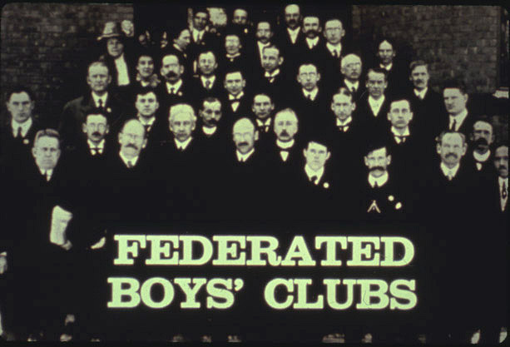
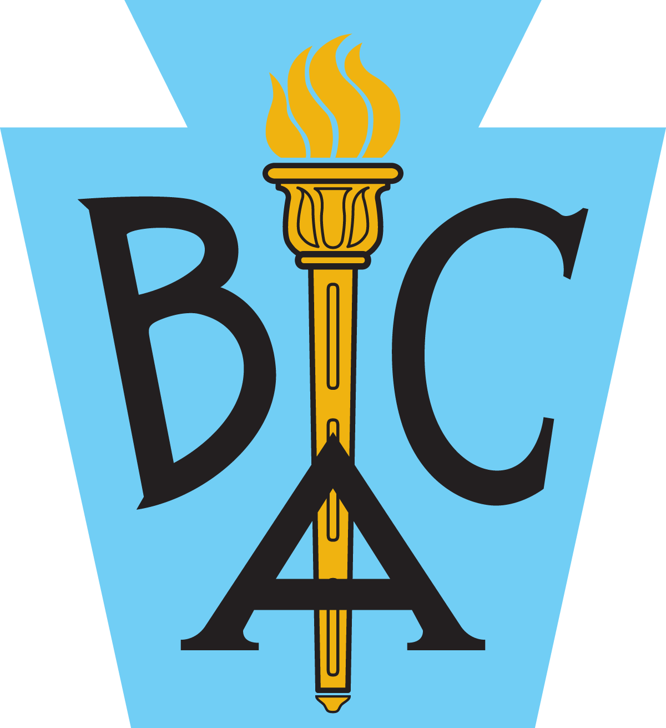




Our Evolution
1915
1941
1990
1906
1929
1980
Notes:
You are part of a long and storied history of the greatest secular Movement in the world.
Founded in 1906 by 53 local organizations and then known as the “Boys Club Federation,” The Boys & Girls Clubs of America has been in continuous operation for 116 years. In that time, the reach of the Boys & Girls Club Movement has grown exponentially, and many changes have taken place. Our current position is a function of continuous evolution, including significant progress and growth over the past 30 years. As we look to the future, our federation must continue to grow, adapt, and evolve so we can produce the best outcomes for America’s youth.
The autonomous nature of local Clubs allows them to be uniquely responsive to local youth needs, enables them to engage top community leaders, and leads to deep and lasting relationships in communities. At the same time, the larger our Movement gets, the more difficult it becomes to achieve consistency, be nimble, and sustain an overall Boys & Girls Club culture. Our growth and the rapidly changing world has made our Federated Model and the role of the Area Councils more important than ever.
Let’s go back to 1906 when 53 individual Boys’ Cubs from across the country untied in Boston, MA to become the Federated Boy’s Club. As I will not go into depth on all the significant changes over the course of our history, but what I do want to emphasize is how incredibly important Area Councils have been in shaping our evolution over the past 100+ years. Area Councils are the voice of our local Clubs and have played a vital role in each of these changes.
(review timeline of our brand)
1915 – Boy’s Clubs Federation adopted a logo
1922 – Harlem Boys’ House became the first african-american youth organziation to join the Boys’ Club Federation.
1929 – Name changed from Boys’ Clubs Federation to Boys’ Clubs of America and a new logo was adopted
1936 – Herbert Hoover became the Chairman of Boys’ Clubs of America and challenged the organization to open at least 1,000 Clubs.
1941 – The Boys’ Clubs of America adopted a new logo.
1947 – Youth of Year Program began
1956 – Boys’ Clubs of America celebrated its 50th Anniversary and was chartered by Congress, a logo was designed to commemorate the moment.
1972 – Boys’ Clubs of America reached 1,000 Club milestone and was serving over 1,000,000 youth
1980 – Boys Clubs of America adopted the logo seen today.
1990 – Boys & Girls Clubs of America symbolizing the true mission of the Clubs to serve all those who need us most.
The autonomous nature of local Clubs allows them to be uniquely responsive to local youth needs, enables them to engage top community leaders, and leads to deep and lasting relationships in communities. At the same time, the larger our Movement gets, the more difficult it becomes to achieve consistency, be nimble, and sustain an overall Boys & Girls Club culture.
The federated model has served us well for over 100 years. We have continually adapted and evolved how we work within that model to advance the Movement and grow national relevance, while maintaining the value derived from local autonomy. As we approach another milestone in our growth, we are looking to our history and to the factors that will influence our future as we consider how we will continue to advance our mission in the years ahead. This leads me to the important role Area Councils play in our evolution.

Slide 4
What Are Area Councils?
Organized in 1944 through BGC Constitution
Supply a clear decision-making process (governance) in our federated model
Ensure engagement and feedback to/from BGCA on important strategic initiatives and changes to membership through robust communications (national to local, local to national, local to local)
Promote the growth, development and effectiveness of the Boys & Girls Club Movement
Educate and motivate board volunteers in a designated geographical area
Notes:
Before we dive into your role, let’s start our conversation today looking more closely at the role of Area Councils.
Area Councils became a formal part of our governance structure in 1944 and were designed to educate, increase engagement and communications, and improve decision making at all levels and focus on governance for the movement. The recommendation to change our name to be inclusive of girls – changing it to Boys & Girls Clubs of America - came from a local Area Council and this completely transformed this Movement. More recently, Area Councils played a very important role in the updates to the membership requirements of Boys & Girls Clubs. Please understand that the role you play here, and the work of Area Councils is not only vital to your local Area Council and Club but is critically important to help ensure this Movement remains relevant and ensure we are providing the highest quality of services to the millions of youth we serve.
(review additional points on slide)
Decision making and engagement - Collectively the Area Council provides feedback as part of our governance model which we will go into greater detail in a few moments.
Promote growth, development and effectiveness – The Area Council provides the opportunity for local Clubs to work collectively with each other to advance and achieve our mission on a state or regional level.
Finally, Area Councils are one of our best vehicles for providing board education and peer to peer learning to drive deeper understanding and engagement.

Slide 5
Area Council
Mission Statement
An effective Area Council becomes the platform for board members and all local organizations to collaborate, educate and share best practices
Collectively the Area Council provides feedback to the NACC member and the National Council on critical National issues as well as to communicate from the NACC to the Area Council
Notes:
So, to summarize, an effective Area Council becomes the platform for board members and all local organizations to collaborate, educate and share best practices
Collectively the Area Council provides feedback to the NACC member and the National Council on critical National issues as well as to communicate from the NACC to the Area Council
Not only is your role to be the voice of your local Club to the Movement, but also to carry information back to your local Club to discuss how to implement.

Slide 6
Federated Model of the Boys & Girls Club Movement
Establishes membership requirements and operating standards; local Clubs are voting members (one vote per org)
National Council
BOG CHAIR
National Board of Governors
Grants and revokes charters; carries out
programs of service to Clubs
NACC CHAIR
Ideas, Recommendations, Feedback
Ideas, National Initiatives, Dialogue
Establishes agenda for
National Council meetings
National Area Council Committee (NACC)
NACC REPRESENTATIVE
AREA COUNCIL CHAIR
Vet proposals for National Council
agenda; consists of one board
member and Club CEO
from every Club in a defined area
(generally a state)
Local Area Councils (AC)
AREA COUNCIL LIAISON (ACL)
Independent entities; must meet eligibility requirements and operating standards
Local Boys & Girls Club Organizations
Notes:
Now let’s touch briefly on the Movement’s Federated model – this model defines how the Movement is governed.
This model defines how the Movement is governed.
The foundation of our governance model is the most important aspect which is the strength of our local Clubs. As you can see from the model, you are the voice of the local Club to the Area Councils.
Collectively, all local member organizations make up the National Council – which is at the top of this model, with each organization getting one vote. This means that Member Organizations collectively determine the policies, standards and requirements by which Clubs are managed and operated.
Local Area Councils vet proposals for a National Council vote, such as proposed changes to membership requirements. Through dialogue and feedback, Area Councils make recommendations to the National Area Council Committee, a concentration of decision makers made up of local Club Board Volunteers who represent multiple Aera Councils, who review governance and communication items that apply across all Area Councils in the Movement. Once this group vets and affirms, they advance recommendations to the National Board of Governors. (take this opportunity to recognize any NACC members on the call). Share that these individuals usually started as the AC Liaison, then AC Chair then NACC member showing how their impact can have a national reach.
The National Board of Governors, who are elected by the National Council, oversees the National BGCA organization. It does not govern local organizations in the movement. The National BGCA team organizes, communicates and provides structure to the running of the movement under the direction of the Board of Governors. Once the Board of Governors affirms the proposed changes, it goes to the National Council for a vote.
The National Council is made up solely of all eligible local BGC organizations (1100+) in the movement each having one vote. Those same organizations formed the base of the pyramid and of our movement. Each organization uses their vote at meetings of the National Council on matters that affect the entire movement. Usually (but not exclusively) votes are held at the Annual National Conference. This system of governance keeps ultimate power in our movement in the hands of local organizations that form our federation
The Federated Model provides for representation of local Clubs and two-way communication across multiple levels, including the Board of Governors, who are elected by the National Council – which, again, is all of you.
The Federated model cannot be changed without approval from a supermajority (2/3 of those voting) of the National Council.

Slide 7
National Area Council Committee Representative
Directory / Contact Information
Midwest
Jim Franklin – jimtfranklin@me.com
Don Harbaugh - dharbaugh@hddholdings.com
Richard Peterson – rpeterson@porteradvertising.com
Guy Smith – gsmith@lillycreekcapital.com
Northeast (includes Puerto Rico)
Phil Jackson - jacksonp@univest.net
Harry Malone-hnmalone+bgc@gmail.com
Joe Pagliaro, JR – joepags68@outlook.com
Guy Smith (IL, WI)
VACANT (NY: Eastern, Western, NY/Long Island, Puerto Rico)
Jim Franklin, (GMAC, MO)
Ann Farrell (WA, AK, OR, ID)
Don Harbaugh (MI, OH, WV)
Harry Malone (NNE, MA)
Joseph A. Pagliaro, Jr.
(CT, RI)
Richard Peterson (IN, KY)
Phil Jackson
(DE, MD, NJ, PA)
Jim Hammack (Northern CA, Coastal CA)
Doug Miller (NV, UT, AZ, San Andreas - CA)
Jan Cundy (MT,WY)
Tony Melson
(NC, TN, VA-DC)
Dr. Dawn Miller (LA Basin, Orange County , San Diego)
Jim Newland (GA, SC )
VACANT (CO, NM)
Jim Petty (AR, KS, OK)
Tony Trevino Jr. (TX:Nor.TX, East TX, South TX, West TX.)
Jon Anderson
(AL, LA, MS)
Arthur Cullen (FL)
Pacific
Ann Farrell - ann.farrell@alignunifythrive.com
Jim Hammack - jim@nerdcrossing.com
Dawn Miller – drdawnmiller@sbcglobal.net
Doug Miller – dpmiller89@yahoo.com
Southwest
Jan Cundy – jan@cundy.biz
Jim Petty - jim@thesrc.com
Tony Trevino, Jr – tonytrevino9@gmail.com
Southeast
Jon Anderson – jander2938@aol.com
Arthur Cullen – arthurcullen@gmail.com
Tony Melson - armelson1@gmail.com
Jim Newland – jamesnewland2@charter.net
Notes:
Use this slide to show the 5 regions for Area Councils and the National Area Council Committee member assignments
Boys & Girls Clubs of America is broken into 5 regions across the country, with each region currently having at least two, and not more than four, representatives of Member Organizations from each of the five regions. These representatives are volunteers, not Club professionals, and act as National Area Council Committee representatives for their region. Recently a new proposal was approved by the National Council to expand that representation to at least 3, but not more than 6, representatives.
• Each NACC representative is responsible for several Area Councils.
• The Chair of NACC is a member of the Board of Governors – currently co-chaired by Robbie Bach and Val McNeely.
Area Councils typically are organized by states, however there are some exceptions like the Greater Midwest Area Council which is made up of multiple states, or some larger states have multiple Area Councils like Texas and California.
Military Clubs and Native organizations have different models of governance but are part of our Area Councils.
You will receive a copy of this presentation after this webinar so you can see who your NACC member is.

Slide 8




Impact and Benefits to Local Organizations
Resources and experiences outside your local Club to address issues and challenges
Opportunity to network with other board members and CEO’s within your state or region on key strategic issues or important topics
Opportunity to interact with regional or national staff on subjects such as Safety, Diversity/Equity/Inclusion (DEI), Resource Development, Policies/Procedures, Governance and staff related issues
Leverage the Boys & Girls Club brand and best practices beyond your local community
Notes:
We know you give generously, especially with your time, and your participation as your organization’s Area Council Liaison also takes time. I’d therefore like to review, you some of the major benefits to being an active participant with your Area Council.
Resources and experiences outside your local Club to address issues and challenges – I am a local board member too, and I have benefitted greatly from learning best practices from my peers on things like how to recruit diverse board members and how to build a positive board culture.
Opportunity to network with other board members and CEO’s within your state or region on key strategic issues or important topics – A great example is the new proposed membership requirements. The proposed changes that are being voted on were developed based on feedback sessions that took place at Area Councils.
Opportunity to interact with regional or national staff on subjects such as Safety, Diversity/Equity/Inclusion (DEI), Resource Development, Policies/Procedures, Governance and staff related issues – National Staff have access and exposure to 100s of Clubs, so their experience and expertise can help your local organization achieve the impact you desire.
Leverage the Boys & Girls Club brand and best practices beyond your local community – The power of this Movement is based on the innovation taking place in local communities all over this country, and how when we come together we can all learn from each other and discover new ways to have the greatest impact on the most youth and communities.

Slide 9
Key Elements of High Performing Area Councils
Quarterly Meetings with at Least 1 Face to Face
Consistent Communication with ACL
AC Strategic Plan
Strong Leadership
Annual Self Evaluation
1. Meeting Attendance
Board engagement is critical to the organizational strength.
2. Personal Unrestricted Financial Gift
Strong boards demonstrate their commitment to the organization through their financial support.
3. Face-to-face Solicitation
Strong boards support the organization’s resource development goals.
4. Annual Personal Engagement Plan
Effective boards clearly define the role each board members plays in the success of the organization.
5. Serving on a Standing Committee or Task Group
Strong boards engage board members in the work that makes a difference to the strength of the organization.
6. Achieving Strategic Initiatives of the Organization
Strong boards have members viewed as leaders in the community with access to people and resources.
Notes:
So, what makes for a high performing Area Council. We think there are 5 key elements.
1. Quarterly meetings with at least one annual Face to Face AC meeting is critical. This is a balance between being able to get things done and keeping people informed and engaged without demanding too much extra time from you as a volunteer board member. High functioning Area Councils provide new board member orientations, CEO/Staff interaction, board member workshops on topical issues, Networking and Recognition
2. Consistent Communication with Area Council Liaisons – This is to ensure ACLs have the information needed to take back to your local organization on strategic, national initiatives and provide you an avenue to share your ideas and feedback. There are resources available to support you in this communication role which we’ll review later in the presentation.
The next 2 elements are very closely related, and those are the AC Strategic plan and the annual self evaluation. We get better and are more effective when we do an annual evaluation and put a plan with metrics in place to drive improvement. We can also use these results to use as benchmarks against other high performing Area Councils.
The strategic plan also includes any statewide initiatives or common goals for all Clubs in that particular Area Council, such as CEO performance plans, building a positive board culture or strategic growth.
Finally, just like in our local Clubs, strong AC leadership is critical to all of our success.

Slide 10
Area Council Governance
The Role of the Chairperson
Notes:
Strong Area Council leadership is critical for a successful, highly impactful Area Council. Let’s take a moment to review the important role of the Area Council Chair and the leadership they provide.

Slide 11
Area Council Officers
An Area Council elects:
• Chair
• Vice Chair
• Treasurer
The Chair appoints:
• Executive Secretary (often the CEO of the Chair’s Organization)
Area Councils include Ex-officio representatives connected to the National BGCA acting as partners:
• NACC Representative
• BGCA Director of Development (DOD)
Every two years
Notes:
Most Area Councils have 3 elected positions: Chair, Vice Chair and Treasurer who typically serve a 2 year term. A best practice is for the Vice Chair to be the Chair-elect, so this position has an opportunity to really learn about Area Councils and what success looks like in order to hit the ground running when they are voted in as Chair.
The consistency in leadership from a two-year term for the Chair followed by a two-year term as Chair by the previous Vice- Chair provides much needed continuity.
Elected Area Council Officers must be Board Volunteers except the Executive Secretary. An Executive Secretary is appointed by the Area Council Chair and is typically the CEO of the chairperson’s organization but can be a designee selected by the chairperson.
The Chair is empowered by the Area Council to appoint committees or task forces to assure interesting, well-planned and effective Area Council meetings.
We also have 2 Ex-officio or non-voting positions which are the National Area Council Committee rep and a BGCA DOD who are there to support and guide the work of the Area Council.

Slide 12
The Chairperson is responsible to give leadership as is necessary to keep the Council active and functioning effectively
Assist In
Guide and Lead
Preside
Appoint
Serve
Encourage
Assist in messaging and engagement to member Area Council organizations on important strategic initiatives and changes to membership from BGCA
Guide and lead the program and work of the Area Council
Preside at all meetings of the Area Council
Appoint committees
Serve as ex-officio member of each committee network
Encourage expansion and improvement of the Boys & Girls Club Movement in the area
Notes:
A strong, active Chairperson is critical for the success of the Area Council. Much like your local organization’s Board Chair, they are responsible for providing leadership as necessary to keep the AC functioning effectively.
(Go through the elements on the screen quickly)
They assist in engaging Area Council member organizations on important initiatives
They guide and lead the Area Council, preside at all meetings, and appoint committees of the Area Council, and serve as ex-officio member of each committee.
Through this important work, the Area Council Chair encourages expansion and improvement of the BGC Movement in the area.

Slide 13
Area Council Liaison Role
Notes:
So now let’s talk about the reason you are all here --- the Area Council Liaison’s role.

Slide 14
Area Council Liaison
The Area Council Liaison (ACL) has the direct responsibility for serving as conduit between the local organization and the greater Boys & Girls Club Movement.
Area Council Liaisons working in Area Councils initiate and review ideas, suggestions and proposals for National Council ultimate consideration and they take action to support, amend or oppose proposals before the National Council.
Notes:
You, as Area Council Liaison, act as a critical conduit - or connection - for the messaging, communication and governance that happens in the Boys & Girls Club Movement.
You also work to initiate and review ideas, suggestions and proposals for the National Council’s consideration, and take action to support, amend or oppose proposals before the National Council.
It is important for you, as Area Council Liaison, to be active on your Club’s board of directors and understand your organization’s goals, priorities, and concerns. Therefore, as a best practice, the Area Council Liaison should be a member of the local organization’s governing board and should serve on the organization’s executive or leadership committee. This provides the most direct and consistent line of communication from the local board leadership to the Area Council.

Slide 15


Why is your Area Council Liaison role important?
Your engagement with Leadership at the local, state, and national level brings:
:
Engage and provide feedback to BGCA on important strategic initiatives and changes to membership
Promote, attend and participate in the annual meeting of the Area Council as well as actively recruiting other board members from their local organization to engage in the meetings and events
Plan for an organized succession to the ACL position prior to their departure
Strategic Thinking
People Leadership
Notes:
The ACL role is important the following reasons:
You provide Strategic Thinking by engaging and providing feedback to BGCA on important strategic initiatives and changes to membership
You provide People Leadership by promoting, attending and participating in the annual meeting of the Area Council as well as actively recruiting other board members from your local organization to engage in the meetings and events.
You also help to plan for an organized succession to the ACL position prior to your departure

Slide 16



Why is your Area Council Liaison role important?
Your engagement with Leadership at the local, state, and national level brings:
:
Engage in quarterly meetings using technology and face to face with other ACL members in their designated Area Council
Attend the annual planning meeting of his/her Area Council, presenting the ideas and suggestions of their Club for consideration on the program of the next Area Council meeting
Ensure that their Club reviews, discusses and adopts a formal position on issues of Boys & Girls Clubs of America governance which may be voted on from time to time
Promote attendance and participation in National Council discussions by members of their local board of directors or other governing body
Provide at least quarterly reports on Area Council activities at their Club board meetings
Accessing Networks
Thought Leadership
Results Leadership
Notes:
You Access Networks by engaging in quarterly meetings using technology and face to face with other ACL members in their designated Area Council, building relationship and engaging in peer-to-peer learning and best practice sharing.
You provide Thought Leadership by attending the annual planning meeting of your Area Council, presenting the ideas and suggestions of your local Club for consideration on the program of the next Area Council meeting
You also ensure that your Club reviews, discusses and adopts a formal position on issues of Boys & Girls Clubs of America governance which may be voted on from time to time
And finally, you provide Results Leadership by promoting attendance and participation in National Council discussions by members of your local board of directors or other governing body and
You have a standing place on the board meeting agenda to provide at least quarterly reports on Area Council activities at your Club board meetings

Slide 17

Your Impact as an Area Council Liaison
Strengthen Local Organizations
Strengthen the Movement
Improved Communications and Decision Making at Local, State, Regional, & National Level
Strong Advocate for Youth
Notes:
At the end of the day, you are providing critical leadership that has a huge impact on our Movement:
Strengthen local orgs and
Strengthen the Movement – This is a continuous cycle where strong orgs create a strong movement which helps to support and create strong orgs.
Improved Communications and Decision Making ( the actual governance) at Local, State, Regional, & National Level
This is what we are all about which is to be a strong advocate for youth and help our organizations have the greatest impact on the most kids and communities.

Slide 18

Valuable Resources
BGCABoards.org is your source for the tools and information boards need!
  Quarterly Area Council & Board Member Slide Deck
  Resource Library including information for: Advocacy, Boards, DEI, Safety, and more!
  Events Calendar with trainings and events focused on you as a board member
Join the BGCA Board LinkedIn Group
  Forum for Board members who serve in the Boys & Girls Club movement intended to foster collaboration, share best practices and improve communication amongst Board members.
BGCA.NET
  BGCA’s intranet website containing information and resources on Programs, Funding, Safety, Marketing and Training. Requires creation of a profile and credentials
Notes:
Links embedded in slide:
https://bgcaboards.org/
https://www.linkedin.com/groups/14086385/
http://www.bgca.net/
BGCAboards.org is a resource for board members. It is not password protected and provides easy access to upcoming trainings and many tools and resources – INCLUDING a quarterly slide deck for Area Councils and Boards resources with updates on key initiatives and resources.
The BGCA Board LinkedIn Group is an open forum for Board members who serve in the Boys & Girls Club movement. It is intended to foster collaboration, share best practices and improve communication amongst Board members. Click the link or search “BGCA Boards” on LinkedIn to join.
BGCA.NET is the Movement’s intranet containing information and resources on programs, funding, safety, marketing, and training. It is also the portal to access data about your individual organizations on participation, revenue trends, and assessment tools for safety, KPIs and standards or organizational effectiveness.

Slide 19
Breakout Rooms
Consider the following questions:
What did you find particularly interesting or surprising from today’s presentation?
What lingering questions do you still have that need an answer?
Is your ACL position well defined and understood at your local organization? What more do you need to do to have it better defined and understood?
How can you be most effective as an ACL at your Area Council meetings? Should you recommend changes to your Area Council Chair in how your Area Council meetings are organized to help you in your role?
What should we include or exclude from this presentation to help future ACLs?
Notes:
OPTIONAL SLIDE
(explain breakout rooms)
We will now separate into breakout rooms for further discussion led by a facilitator that may be National Staff or NACC members. We will bring everyone back for a short debrief to end our day.
During your discussion, please reflect on today’s session and share your key takeaways.
Consider the following questions:
What did you find particularly interesting or surprising from today’s presentation?
What lingering questions do you still have that need an answer?
Is your ACL position well defined and understood at your local organization? What more do you need to do to have it better defined and understood?
How can you be most effective as an ACL at your Area Council meetings? Should you recommend changes to your Area Council Chair in how your Area Council meetings are organized to help you in your role?
What should we include or exclude from this presentation to help future ACLs?

Slide 20
Questions
Notes:
Thank you again for serving in this important role as an Area Council Liaison for your organization. We will send a follow up email with the slides from today and the recording on the session – and Please do not hesitate to reach out to your DOD or National Area Council Representative should you need further support.
This concludes our session.

